Slide 1

Immersive Wargaming
Use this cover for most presentations
Booz Allen Hamilton internal
To replace the current photo, click on it and hit “delete.” Drag your new image into the photo placeholder box.
Click here to access photo library.
Photos may feature:
Employees
People benefiting from our solutions
A human element, such as a close up of a hand or a person in the distance
Ashish Israni, James Harrison, Connor Hughes, Arvindh Natajaran, Tremaine Ng, Casey Pham
Innovation center, Washington, D.C.
August 2017

Slide 2
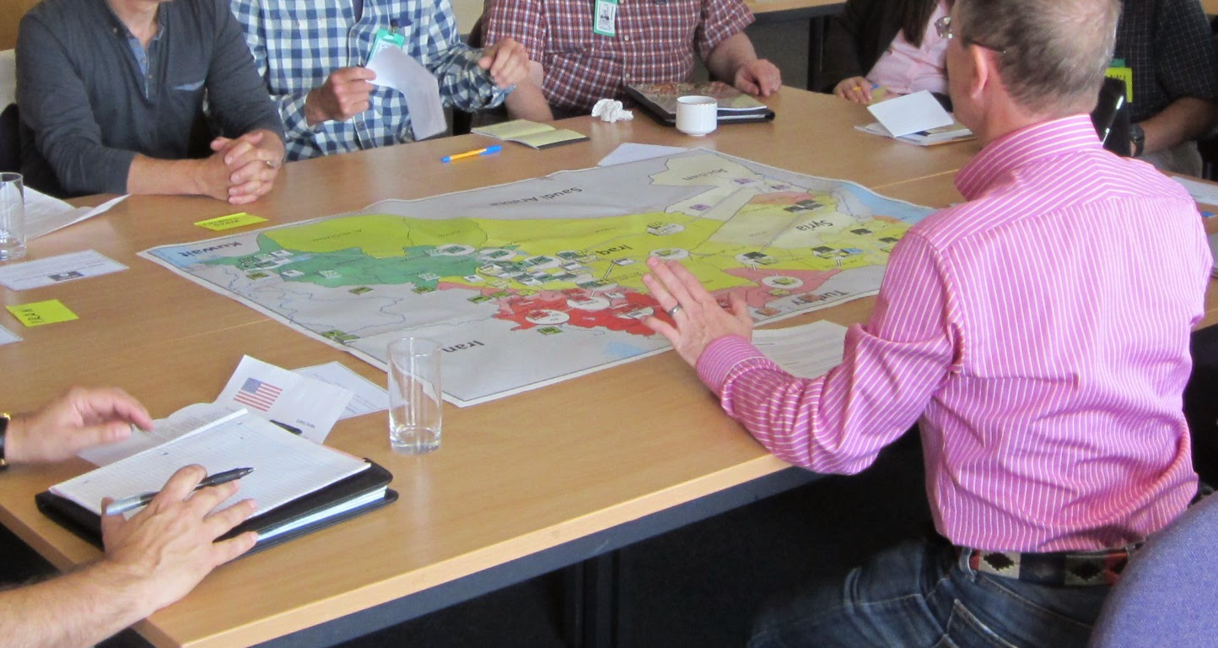
Let’s play a game
Booz Allen Hamilton Internal
Notes:
Hook: Drop thick paper wargaming manuals on stage to emphasize thickness and difficulty

Slide 3

"As a warfighter and military commander, I know the importance of using wargames to test strategy and plans before risking blood and treasure” -Gen. Anthony Zinni

Slide 4
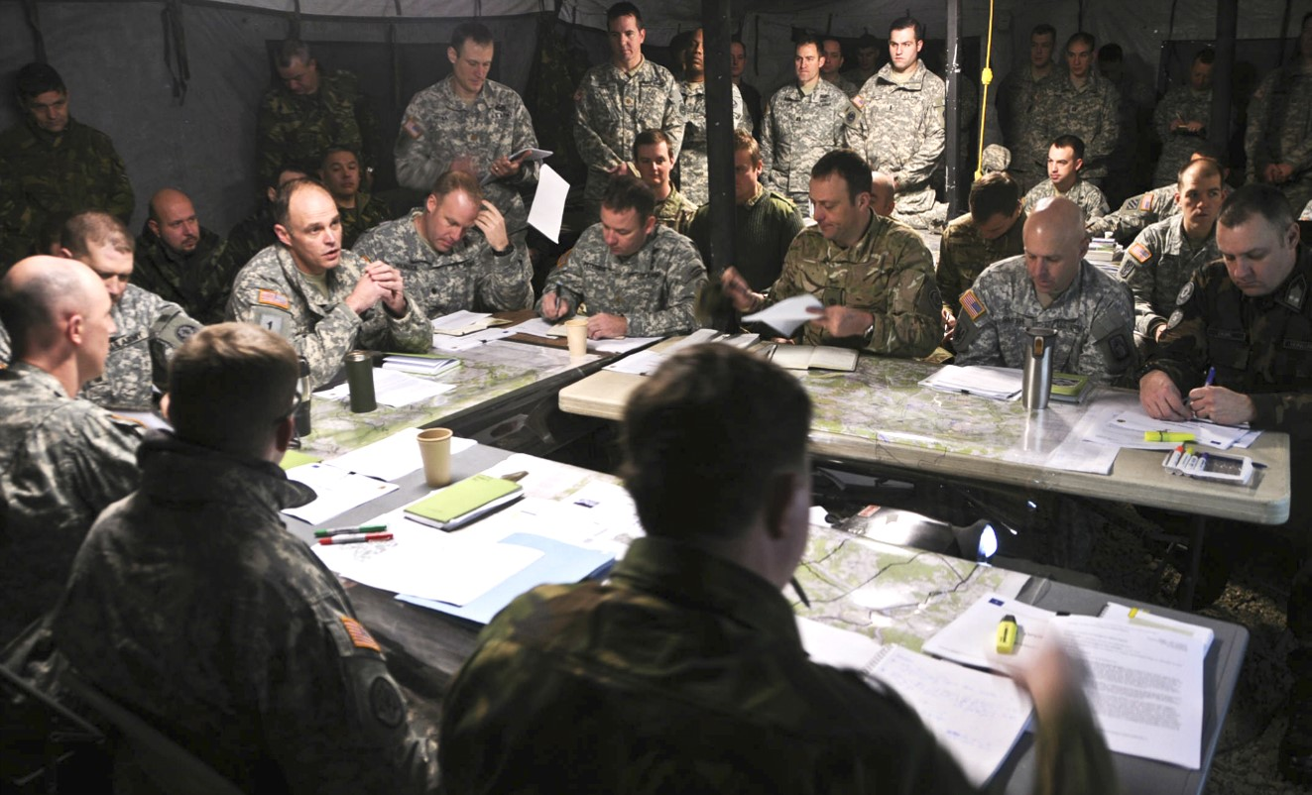
Current State of Wargaming
Booz Allen Hamilton Internal

Slide 5
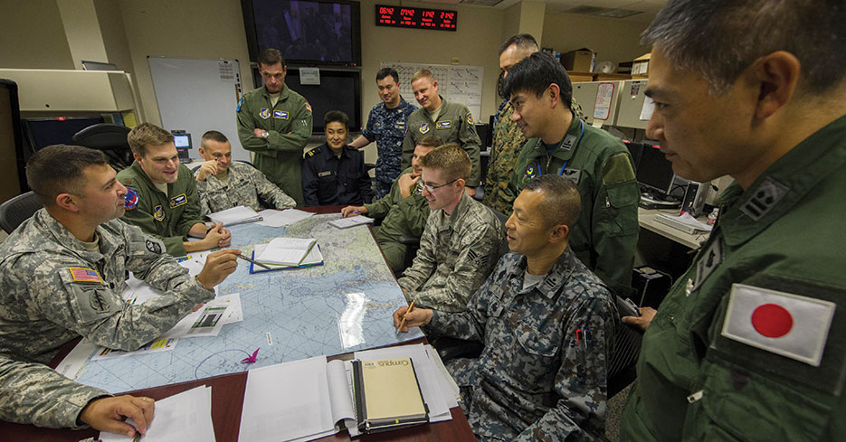

Current State of Wargaming
Ease of collaboration
Adaptability
Engaging
Time efficient
Actionable

Slide 6

“Gaming is a people-driven tool that is effective at examining decision-making, exploring issues, explaining implications, and identifying questions for future study.”
- Jeff Wong, Marine Officer Reservist
“Wargaming, once only a discipline used in military preparation, has emerged as a driving force in shaping strategies in corporate boardrooms….”
– Michael McConnell, Director of National Intelligence
Notes:
Quantify opportunity: Explain uses, impact, and importance of wargaming and similar tabletop exercises

Slide 7
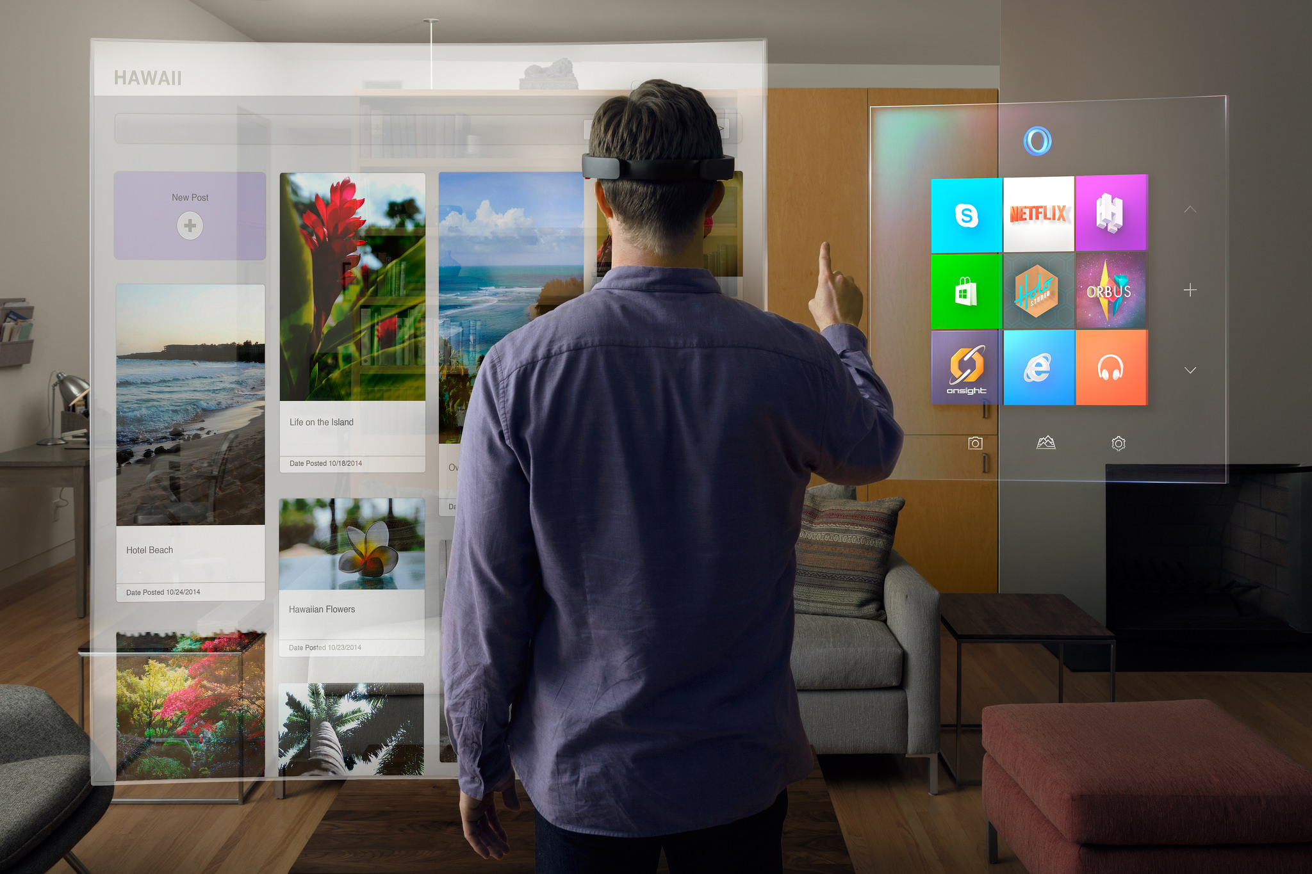
Augmented Reality

Slide 8
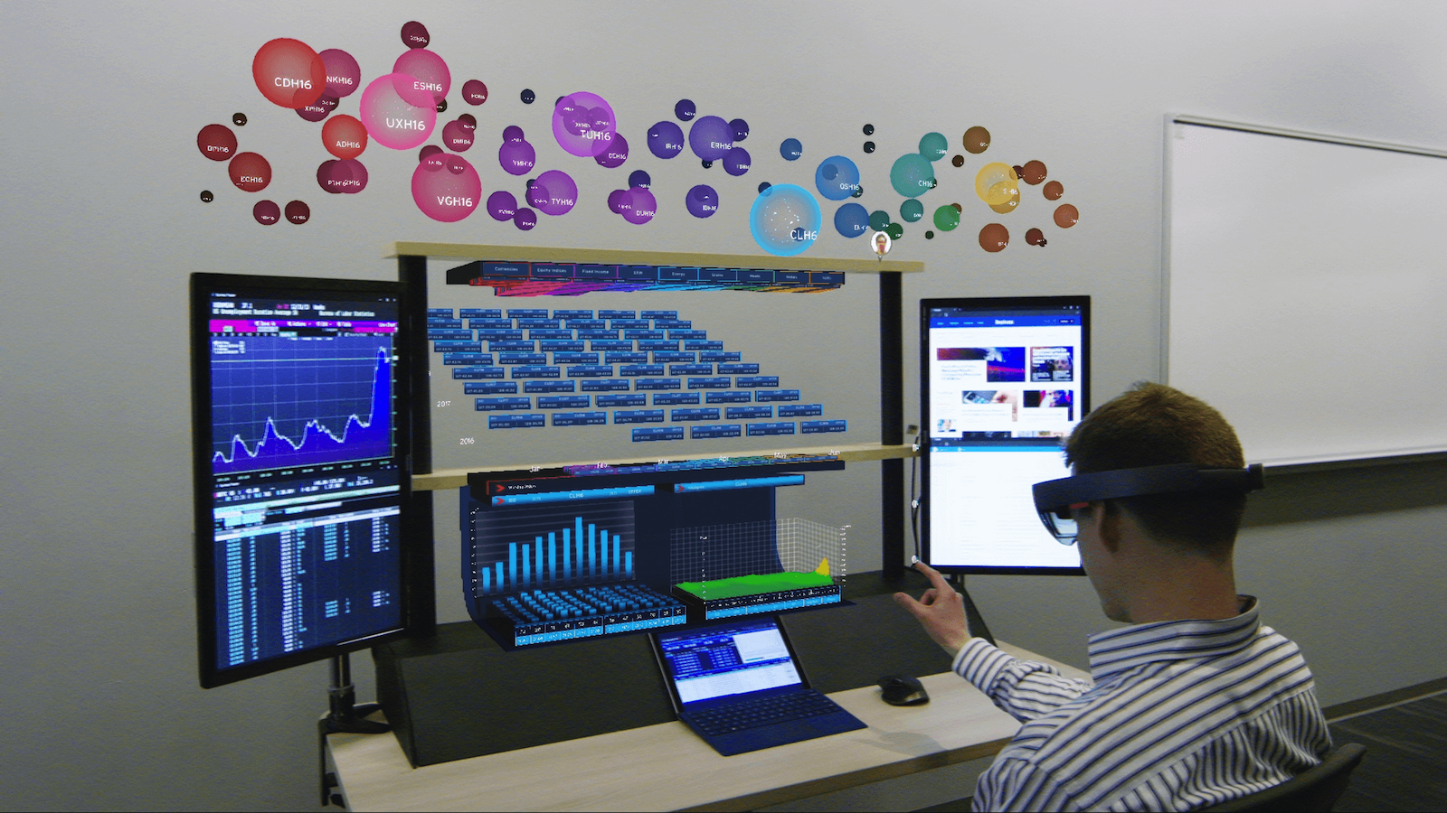
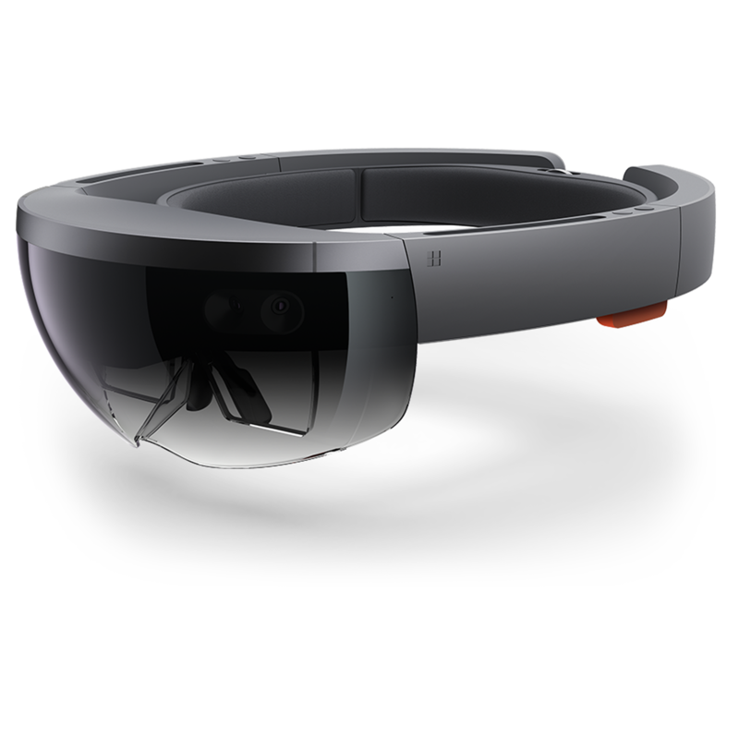
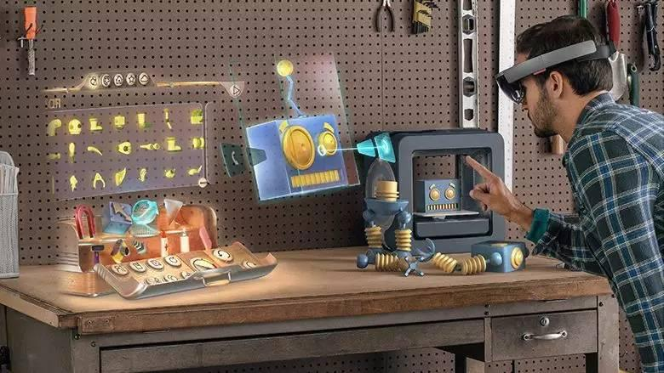
What is Augmented Reality (AR)
“…augmented reality technology lets people see digital imagery overlaid onto the physical world”
- Fortune
Microsoft Hololens

Slide 9
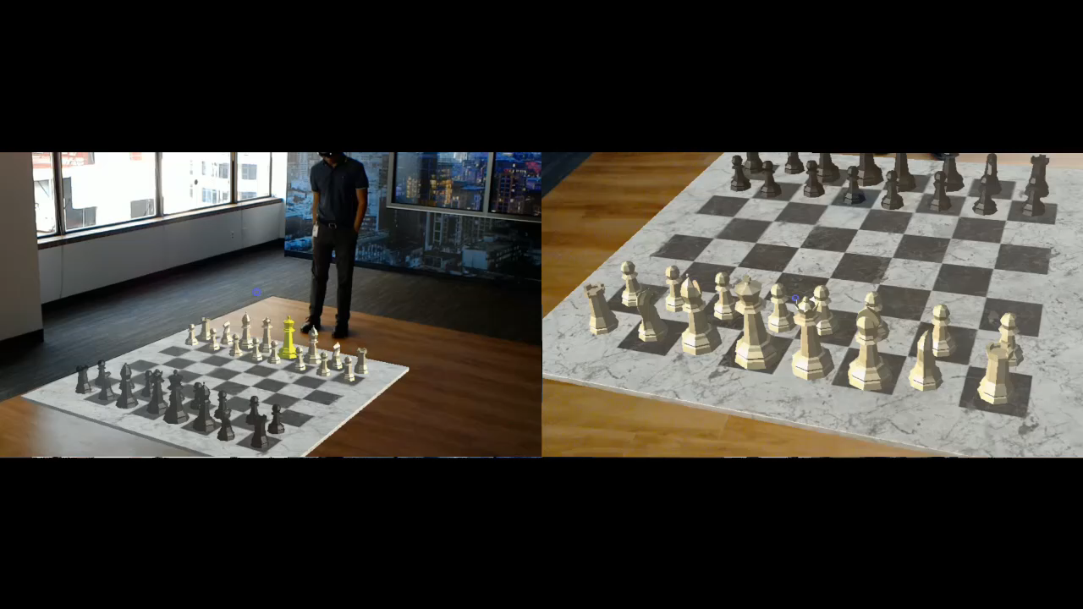
Chess demo

Slide 10
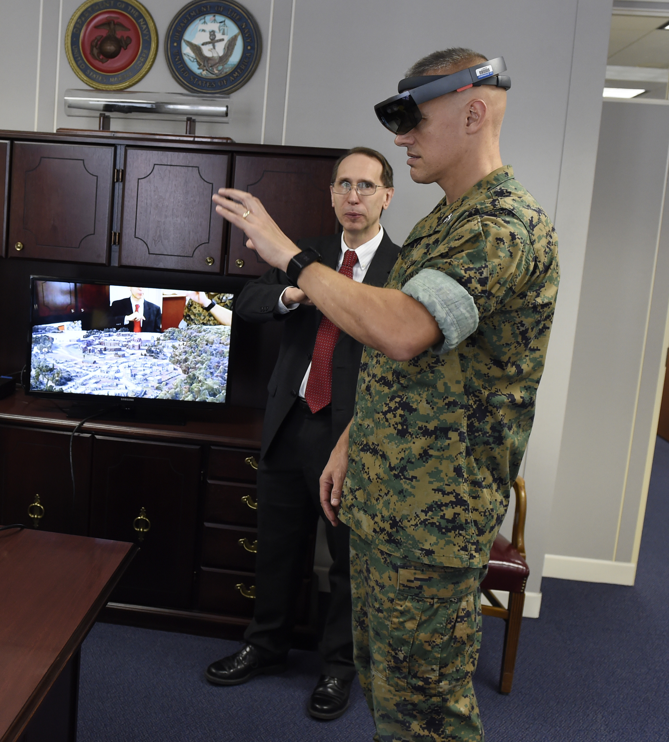
Wargaming in AR
Simple
Intuitive to pick up and play
Immersive
Provides a realistic experience
Efficient
Parallel to existing wargames

Slide 11
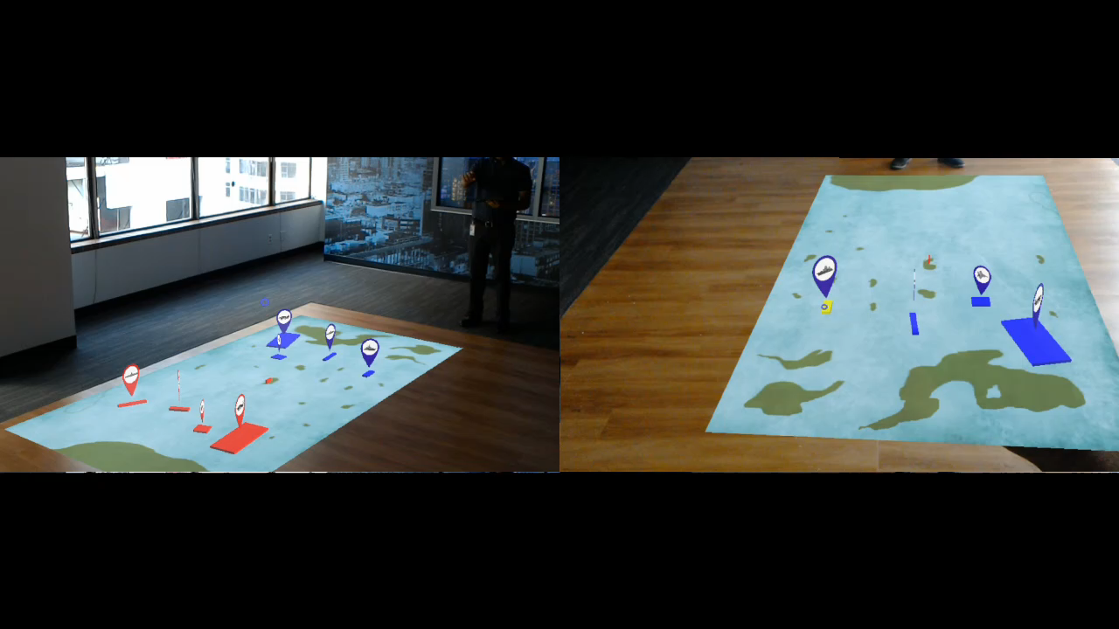
Product demo

Slide 12
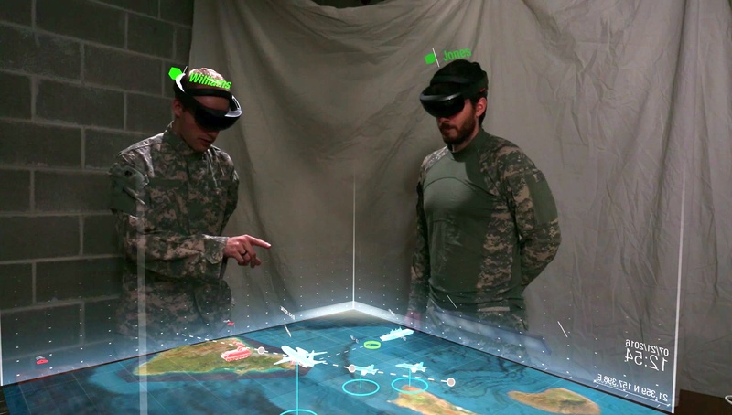
AR Wargaming Potential
Ease of collaboration
Adaptability
Engaging
Time efficient
Actionable
Booz Allen Hamilton Internal
Notes:
Hook: Drop thick paper wargaming manuals on stage to emphasize thickness and difficulty

Slide 13
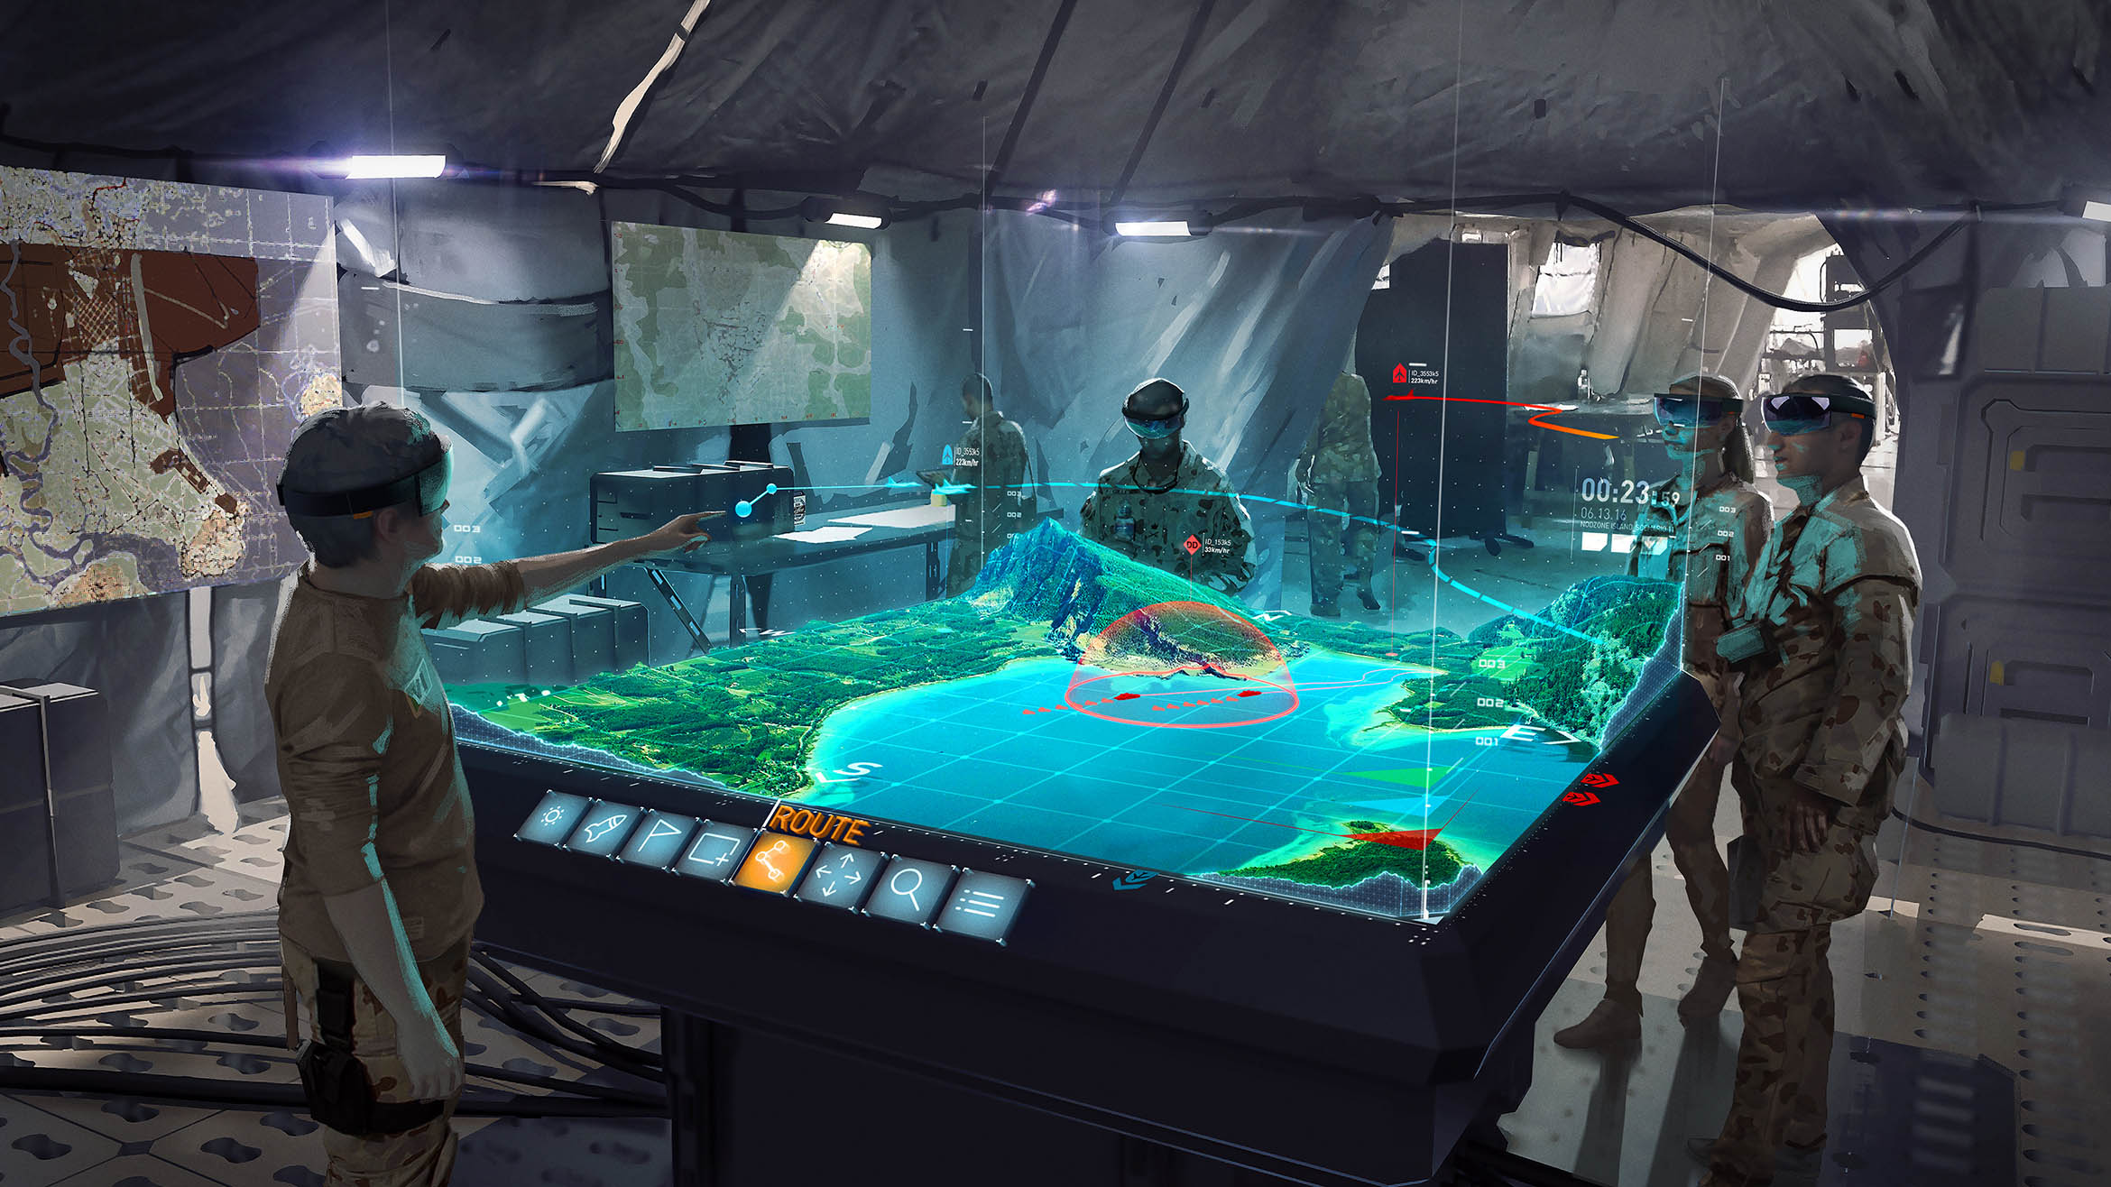
Future Plans

Slide 14
Future Plans
Strategy meets Operations
Heighten combat readiness
Incorporate operational training
with strategic planning
Bring the battlefield to the
boardroom…
AR tech can go from training aid to communication device as needed

Slide 15
Future Plans
Strategy meets Operations
Cross-Market AR Applications
Heighten combat readiness
Incorporate operational training
with strategic planning
Bring the battlefield to the
boardroom…
AR tech can go from training aid to communication device as needed
Improved info visualization adds value to all types of wargames
See complex scenarios like never before
Re-watching gameplay enhances post-game analysis
New communication capabilities

Slide 16
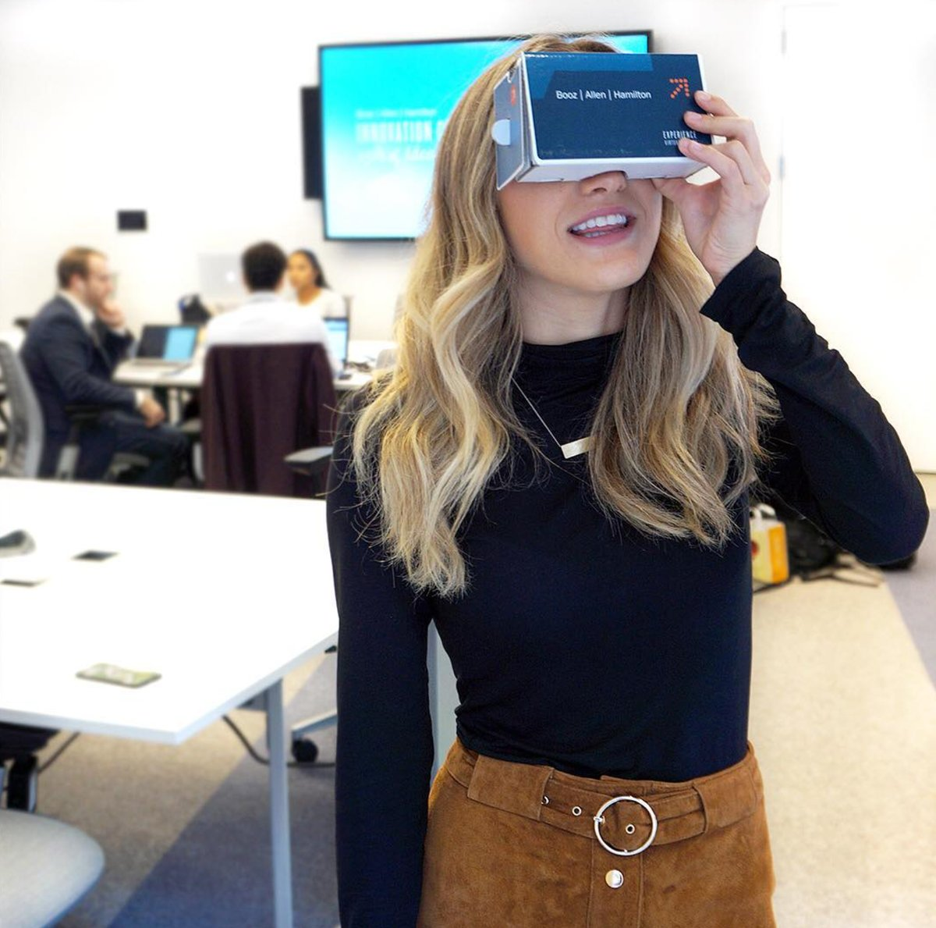





Why Booz allen Hamilton?
100
years of wargaming experience
Interested clients
Augmented Reality developers

Slide 17





Moving forward
Take advantage of Taqtile partnership
Integrate with OceanLens
Invest time and money
Stay up-to-date with new tech

Slide 18
Questions

Slide 19
Appendix

Slide 20
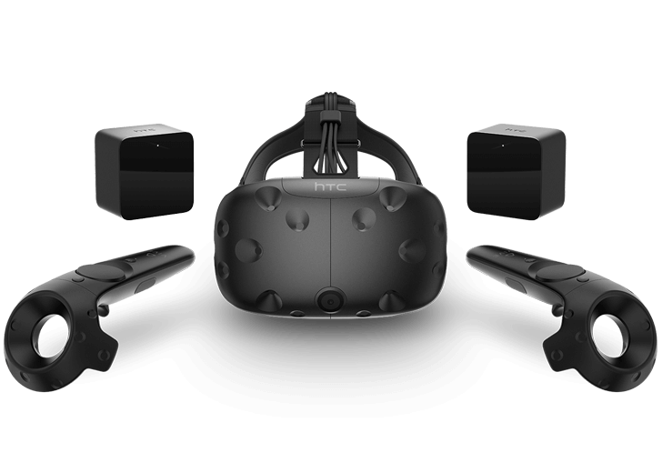
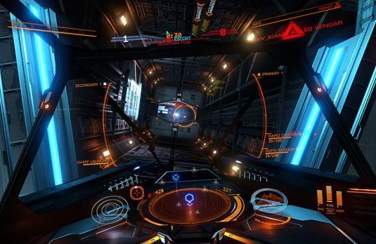
What is AR/VR
Microsoft Hololens (AR)
“Mixed reality brings people, places, and objects from your physical and digital worlds together.”
- Microsoft
“Putting on the VIVE headset washes away the real world with fantastical experiences….”
- HTC
HTC Vive (VR)
Hololens and Vive images not to scale

Slide 21


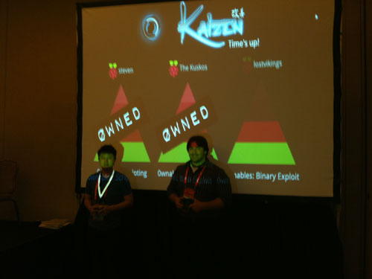
Cyber Security
AR Technology Can Help Attract, Train, and Retain
”… the skills shortage [in cybersecurity] has created a job market that represents an existential threat to those companies that can’t retain adequate cybersecurity talent…”
Attract
Technology appeal
Train
Wargames and other simulations
Wargame in a box
Retain
Maintain readiness through practical exercises
Competitive hacking events using AR
Booz Allen’s “Kaizen” cybersecurity Capture-the-Flag Event

